Slide 1
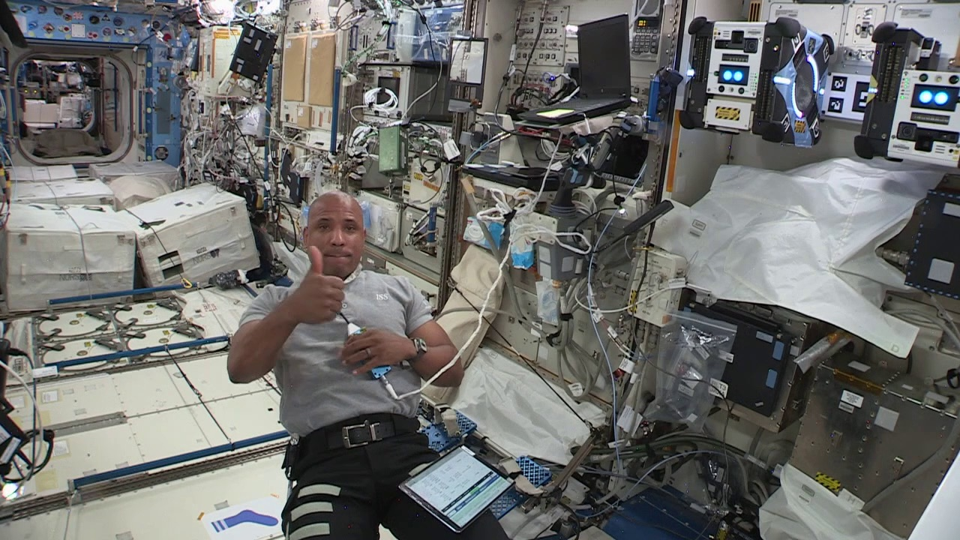
Trey Smith¹, Maria Bualat¹, Abiola Akanni¹, Oleg Alexandrov^{1,3}, Laura Barron², J Benton¹, Gabriel Chuang¹, Brian Coltin^{1,3}, Terry Fong¹, Janette Garcia², Kathryn Hamilton¹, Lewis Hill^{2,4}, Marina Moreira^{1,3}, Robert Morris¹, Nicole Ortega^{2,4}, Joseph Pea^{1,3}, Jonathan Rogers², Misha Savchenko^{2,5}, Khaled Sharif^{1,3}, Ryan Soussan^{1,3} ¹NASA Ames Research Center, Moffett Field, CA ²NASA Johnson Space Center, Houston, TX ³KBR Wyle Services, LLC ⁴Jacobs Technology, Inc. ⁵METECS ISS R&D Conference, Virtual, 2021/08/17
ISAAC: An Integrated System for Autonomous and Adaptive Caretaking
Notes:
Hi, I’m Trey Smith. This presentation describes progress so far on the ISAAC project.

Slide 2
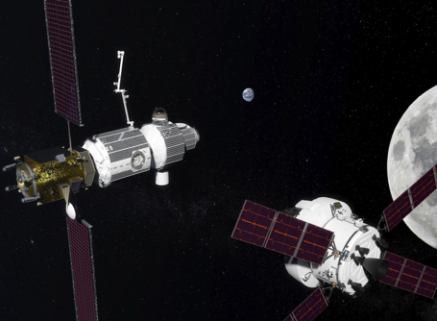
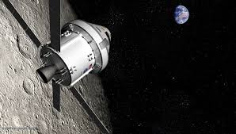
ISAAC Overview
Research project, 2020-2022, to develop technology for autonomous caretaking of spacecraft primarily during uncrewed mission phases
Led by NASA Ames Research Center with collaboration from Johnson Space Center
Integrate autonomous intra-vehicular robots (IVR) with spacecraft infrastructure (power, life support, etc.) and ground control
Focus on capabilities required for the Gateway that also apply to human missions to Mars and beyond
Test with existing IVR on the ISS (Astrobee, Robonaut) as an analog for future IVR on Gateway
Do not:
Develop the IVR needed for Gateway
Develop Gateway flight software
(These tasks are vital but not part of ISAAC.)
Notes:
ISAAC is a three-year research project running from 2020 to 2022.
We're developing technology for autonomous caretaking of spacecraft primarily during uncrewed mission phases. ISAAC is led by NASA Ames Research Center with collaboration from Johnson Space Center.
Our goal is to integrate autonomous intra-vehicular robots, or IVR, both with spacecraft infrastructure systems like power and life support, as well as with ground control.
We're focusing on capabilities required for NASA's Gateway outpost near the Moon, but that also apply to human missions to Mars and beyond.
Our approach is to test with existing IVR on the ISS, robots like Astrobee and Robonaut, but we're using them as an analog for future IVR that will be deployed on Gateway.
Some things that are not in scope for ISAAC are developing the IVR needed for Gateway or developing Gateway flight software. Those are vital tasks but not what we’re working on here.

Slide 3
Why ISAAC?
Gateway will be uncrewed for extended periods. During these periods NASA needs autonomous systems that can perform:
Fault Detection, Isolation, and Recovery (FDIR)
Routine maintenance
Logistics operations
All through high latency communication to ground controllers
Autonomous systems can free crew from routine maintenance and logistics tasks
Gateway Ground Rules & Assumptions has crew spending 3.5 hours/day working non-utilization/non-exercise tasks
ISAAC provides the glue between Intra-Vehicular Robotics (IVR) and vehicle systems (power, life support, etc.) through
Integrated data
Coordinated execution
Integrated control interface
Infusion into Gateway:
Interaction with Gateway Working Groups: IVR and Vehicle System Manager
ISAAC MOU with Gateway
Notes:
The ISAAC project is motivated by recognizing that future human missions like the Gateway will be uncrewed for extended periods. During these periods we need autonomous systems that can:
- Detect, isolate, and recover from faults
- Perform routine maintenance
- Transfer cargo and track inventory
- A variety of other tasks.
Through all of this, we have to minimize our reliance on ground operators because of the long communication latency and extended loss-of-signal periods.
You can get a sense of the possible impact of ISAAC by noticing that the Gateway Ground Rules & Assumptions assume that crew will spend 3.5 hours each day working on non-utilization / non-exercise tasks, so if we can offload a significant amount of that time, that’s a big win for crew productivity and science utilization.
ISAAC is providing the glue between robots and vehicle systems through three technical thrusts: integrated data, coordinated execution, and an integrated control interface, which I’ll go through on the next few slides.
Our infusion path into Gateway is through interacting with two of the Gateway working groups for Intra-Vehicular Robotics and the Vehicle System Manager coordination software. The ISAAC project also has a memorandum of understanding with the Gateway Program.

Slide 4
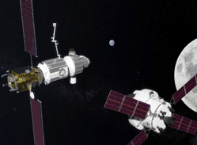
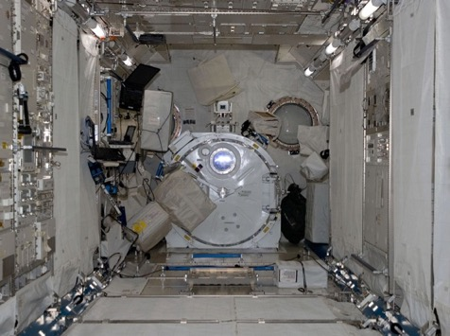
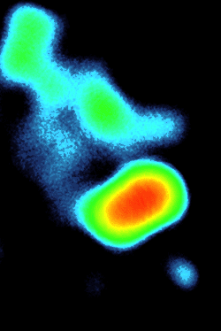
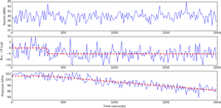
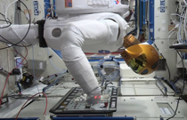
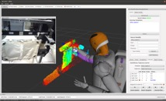
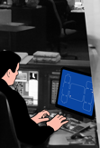
Technical Thrusts
Gateway
Spacecraft Subsystems
ECLSS
GN&C
Therm.
EPS
Comm
Struct.
Integrated System Manager
4
Mission Control
Notes:
Now we’ll go over ISAAC’s three technical thrusts

Slide 5
Technology: Integrated Data
Gateway
Spacecraft Subsystems
ECLSS
GN&C
Therm.
EPS
Comm
Struct.
Integrated Data
Integrated System Manager
5
Mission Control
Notes:
The Integrated Data thrust is about unifying telemetry from the different subsystems and robots, and making it available for integrated analysis, whether that is serving onboard autonomy or operator situation awareness.
Using a motivating example of a leak caused by a micrometeoroid impact, you would detect the leak using life support pressure sensing and isolate the location of the leak using robotic sensing. These are different telemetry sources, but for fault management, to understand the situation, you need to have access to both sources, and they need to be linked and registered with each other.

Slide 6
Technology: Coordinated Execution
Gateway
Spacecraft Subsystems
ECLSS
GN&C
Therm.
EPS
Comm
Struct.
Coordinated Execution
Integrated System Manager
6
Mission Control
Notes:
The Coordinated Execution thrust is about unifying the commanding framework between spacecraft subsystems and robots and bringing in higher-level management so you can have the components collaborate effectively.
In the leak scenario, you detect the leak with vehicle sensing, isolate the leak with a mobile inspector robot, and patch the leak with a mobile manipulator robot. But clearly you need a higher-level manager to coordinate this task, and the commanding of the different components needs to be linked and registered in common terms. For example, we need to have a common frame of reference, so the mobile inspector can communicate the leak location in terms that the mobile manipulator understands.

Slide 7
Technology: Integrated Control Interface
Gateway
Spacecraft Subsystems
ECLSS
GN&C
Therm.
EPS
Comm
Struct.
Integrated Control Interface
Integrated System Manager
7
Mission Control
Notes:
And ISAAC’s final technical thrust is an Integrated Control Interface.
This thrust is about unifying things not just on the spacecraft side, but also on the ground side. For example, if your fault diagnosis engine gathers clues across subsystems, your operator interface should be able to show you all of that information together in one place. And operators need good situation awareness about all the threads of coordinated execution so they can intervene if needed.

Slide 8
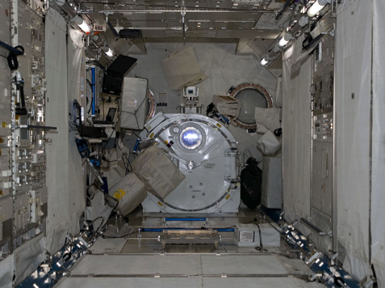
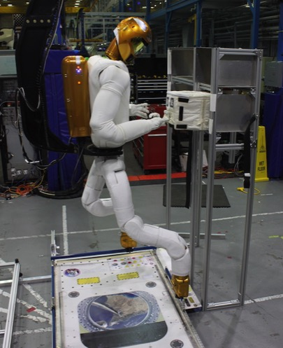
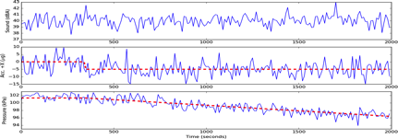
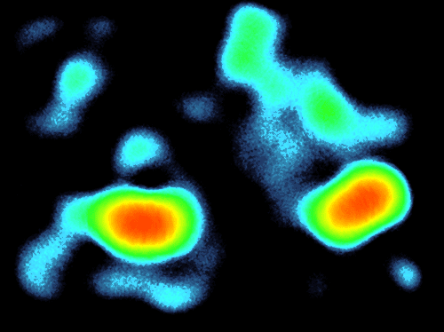
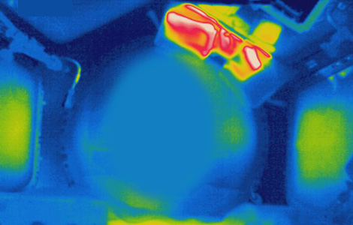
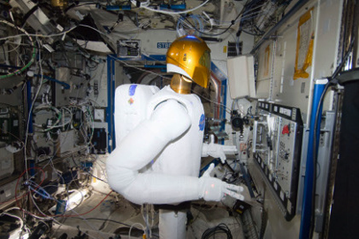
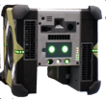
Capability Areas
Autonomous State Assessment
Autonomous Logistics Management
Integrated Fault Management
Structure
Detect Leak
GN&C
ECLSS
Locate Leak
Localizing signal sources by analyzing signal strength variation
Robotic cargo transfer
Patch Leak
Habitat thermal mapping
Notes:
The technical thrusts we just discussed are cross-cutting for a variety of applications. We also have what we call capability areas, or ways we can apply those technical thrusts.
Autonomous state assessment is about staying aware of the vehicle state during uncrewed periods, using IVR and vehicle sensing together to identify any developing issues.
Autonomous logistics management is looking at a cargo transfer scenario, with the background that we may have uncrewed cargo vehicles visiting Gateway. The robots should be able to handle unpacking them and save the crew time.
Integrated fault management looks at how vehicle subsystems and IVR can work together to manage faults, as in our motivating scenario with the leak.

Slide 9
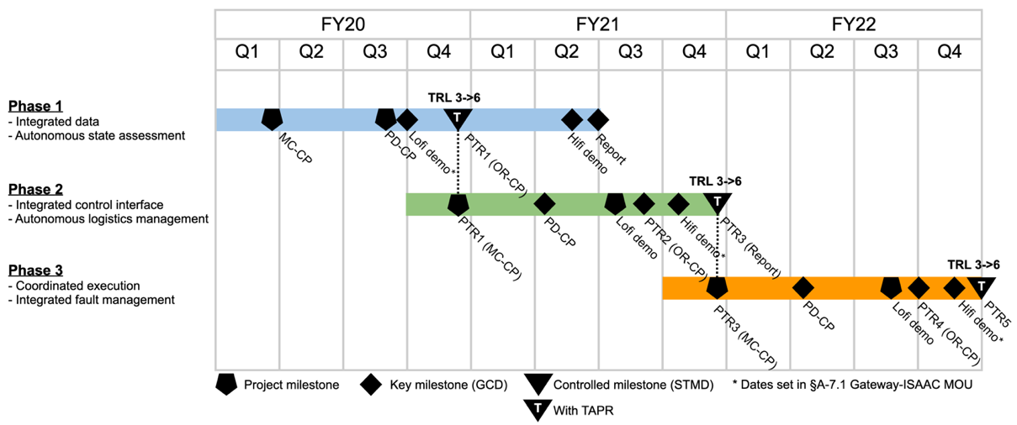
Schedule
FY19
FY20
FY21
FY22
ISAAC
ISAAC Formulation
We are here
Notes:
This schedule gives the context that we are nearing the end of year two in our three year project.
The project is split up into three phases that last more or less one year each. Today we’ll talk about final results from phase 1 and preliminary results from phase 2.

Slide 10
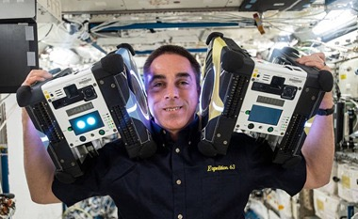
Background: Astrobee
Three Astrobee free-flying robots were launched to the ISS in 2019
Capability overview
Battery-powered fan propulsion, six degree-of-freedom holonomic control
Suite of cameras provides LIDAR point clouds and RGB imagery
Flies autonomously, generally with ground operator oversight
Autonomously docks for recharging and uses arm to perch on astronaut handrails
Vision-based navigation, can fly throughout ISS US Operating Segment
Guest scientists can install payloads and modify Astrobee flight software
Objectives
Provide a microgravity robotic research facility inside the ISS
Demonstrate feasibility of intra-vehicular robot caretaking
Provide an opportunity to automate certain ISS operations
Driving use cases
Guest science experiments
Remotely operated mobile camera
Sensor surveys
The ISAAC project works closely with the ISS Astrobee Facility through its guest science program
You could be an Astrobee guest scientist, too!
https://www.nasa.gov/astrobee/
https://www.nasa.gov/content/guest-science-resources
Barlow, et al. Astrobee: A Free Flying Robot Enabling Technology Demonstrations. Proc. ISS R&D Conf., 2021
Notes:
But before we get into the ISAAC phase 1 results that involve the Astrobee robot, I wanted to provide some background on Astrobee for anyone who hasn’t watched Jonathan Barlow’s presentation earlier in the same conference session.
Three Astrobee free-flying robots were launched to the ISS in 2019.
Each Astrobee:
Uses battery-powered fans for propulsion, providing six degree-of-freedom holonomic control
Carries a suite of cameras that provide both LIDAR point clouds and RGB imagery
Flies autonomously, although generally under the oversight of a ground operator
Uses vision-based navigation, enabling it to fly throughout the ISS US Operating Segment
Is available for guest scientists to add payloads and modify the flight software
Astrobee was developed with three main objectives in mind:
To provide a flexible microgravity robotic research facility inside the ISS
To demonstrate feasibility of intra-vehicular robotic caretaking—in other words, to enable projects like ISAAC
To provide an opportunity to automate certain ISS operations
And there were three main use cases driving the Astrobee design:
Running a broad variety of experiments, whatever guest scientists can cook up
Acting as a remotely operated mobile camera to improve situation awareness of mission controllers
Collecting sensor surveys throughout the ISS, which is currently a dull and time-consuming task for astronauts
We on the ISAAC project work closely with the ISS Astrobee Facility through its guest science program.
You could do research with Astrobee, too! If you’re interested in space robotics research, I encourage you to check into Astrobee guest science. It’s a very unique platform. And of course you can also check out Jonathan Barlow’s talk from earlier in this conference session.

Slide 11
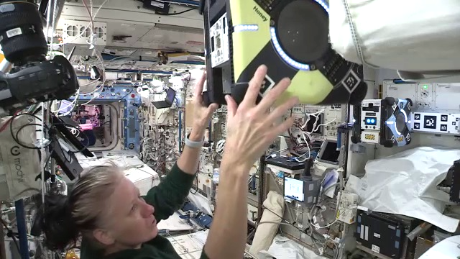
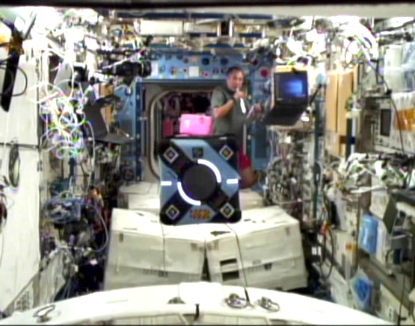
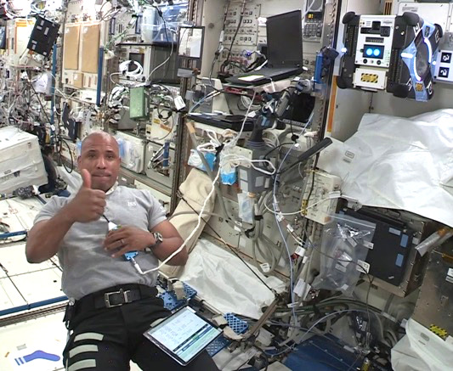
ISAAC Phase 1 ISS Activities
ISAAC-1
ISAAC-2
ISAAC-3
2021/02/23
2021/03/26
2021/04/19
NASA astronaut Shannon Walker manually moving Honey near target to collect calibration imagery
JAXA astronaut Soichi Noguchi pauses to watch Bumble conducting a multi-sensor map survey
NASA astronaut Victor J. Glover configuring the JEM module for Astrobee ops
Calibrate sensors
Validate mapping approach with a small survey
Cover full survey area
Build baseline 3D geometry and high-res surface texture
Respond to simulated CO₂ fault with Astrobee inspection
Automated detection of anomalous object blocking vent
Cover full survey area again
Stream live 3D surface texture updates to operator
Notes:
Back to ISAAC phase 1, which included three ISS activities.
ISAAC-1, in February, gave us a chance to calibrate Astrobee sensors and validate ISAAC’s mapping approach with a small survey.
During ISAAC-2, in March, Astrobee flew a full survey, covering about ¼ of the Japanese Kibo module, and we used the data to create a baseline 3D map with high-resolution surface texture.
ISAAC-3, in April, was the main demonstration. We ran a fault scenario where Astrobee performed a targeted inspection and detected an anomaly, and Astrobee also repeated its 3D mapping survey while streaming live 3D surface texture updates to an operator.

Slide 12
Fault Demo Video
Notes:
Let’s get right into our demonstration videos, starting with a fault management scenario.
First, we’ll show the software simulation version. You’ll see a view of ISAAC’s integrated control interface, which includes multiple panes for viewing different types of data together in a single interface, in this case both time series telemetry and a 3D view of the vehicle interior. To start the scenario, we’ve injected a high-CO₂ anomaly in our simulated ISS life support telemetry. Then the vehicle system manager reacts to the fault by sending Astrobee to investigate one of the possible root causes, namely that a life support return vent is blocked. When Astrobee arrives, it images the area, and ISAAC’s anomaly detector discovers that, sure enough, the vent is blocked, in this case with a lost astronaut sock that was sucked onto the vent. At this point, the vehicle system manager’s logical next step would be commanding Robonaut to clear the vent, but we didn’t include that in the demo.
Next, we’ll see the same scenario executed on the ISS. It looks a bit different for practical reasons: most obviously, it would have been a bit weird to ask to borrow an actual astronaut sock, so we printed out a picture of one instead. You’ll see the same inspection action in three different views: first from an ISS camcorder, second what Astrobee itself saw using its navigation camera, and finally, what the ground operator would see in ISAAC’s integrated control interface.

Slide 13
Survey Demo Video
Notes:
In our second demonstration video, Astrobee flies an autonomous survey pattern to collect multi-sensor imagery and build a 3D map.
This data was collected during our third ISS activity and we’re playing it on fast forward so we can get through it quickly.
In the video, we cycle between three different views. One is from an ISS camcorder watching Astrobee. One is what Astrobee itself sees with its navigation camera. The last is what the ground operator sees in our ISAAC interface, which provides a live view of Astrobee’s position, and the 3D map that the ISAAC software is building as the data streams in from Astrobee.
During this survey, Astrobee autonomously flew a coverage pattern that covered about 1/4 of the Japanese Kibo module of the ISS. An automated planner optimized the coverage pattern to collect a complete set of high-quality image data in minimum time. A ground operator was overseeing execution and they did have to step in a couple of times to get Astrobee back on track after hiccups in execution.
At the end we’ll take a tour of the final 3D map. First, we have an overview showing the whole model. Then we see the aft wall of Kibo, then the forward wall, then looking down at the deck, then looking up at the overhead. Last, we zoom in to full resolution which, as you can see, is good enough to pick out a lot of fine detail and even read inventory labels.

Slide 14
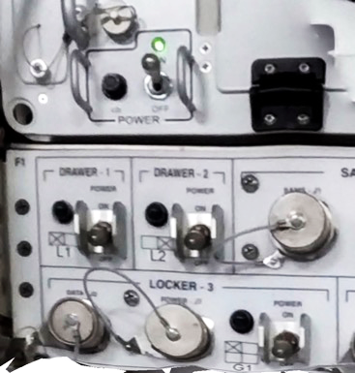
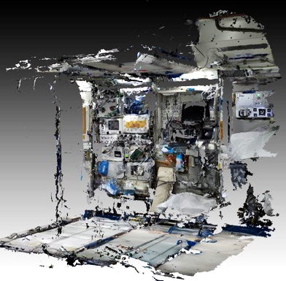
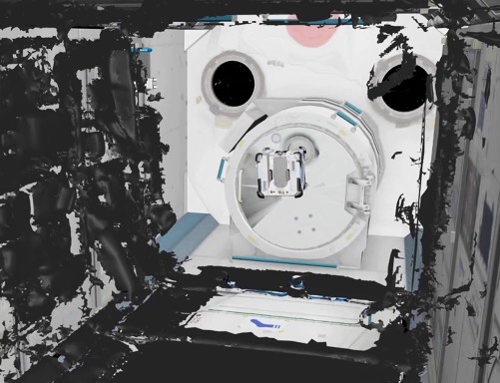
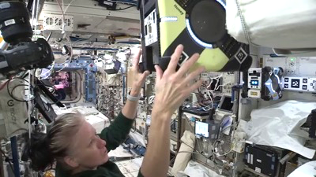
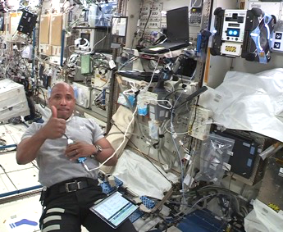
Phase 1 Summary
Multi-Sensor Mapping
Anomaly Detection
Integrated Demonstrations
Demonstrated multi-sensor mapping and anomaly detection
Performed three integrated demonstrations on ISS
Notes:
The two videos we just showed provided a quick overview of ISAAC phase 1, which demonstrated multi-sensor mapping and anomaly detection during three activities on the ISS.

Slide 15
Phase 2 Preliminary Demo Video
Notes:
Our last video shows some preliminary results from ISAAC phase 2, which is focused on a multi-robot cargo transport scenario.
In this preliminary version of the scenario, Robonaut and Astrobee cooperate to transfer an ISS cargo bag into the ISS Kibo module from the Destiny module. We’re using ISS modules and ISS robots as an analog to the eventual target application, which is transferring cargo into the Gateway from a visiting cargo vehicle.
Transferring a cargo bag is a two-step process. First, Robonaut would use its capable human-like hands to unbuckle the bag’s launch harness and park the bag temporarily on a nearby magnetic fixture. Then, Astrobee, which can move faster between modules, would fetch the bag and carry it to a stowage location in the Gateway. This approach makes best use of the different capabilities of the two robots and further shortens the total execution time because the robots can work in parallel.

Slide 16
Phase 2 Preliminary Demo Video
Notes:
Our software simulation demo starts with an operator setting the goal that the bag should end up in the target location.
Then the automated planning system generates a multi-robot plan to achieve the goal. You can see the plan steps here.
During execution, the operator can follow along and see what step is currently in progress.
Robonaut first needs to move into position to pick up the bag. Its motion planner calculates the shortest path for moving its feet and torso so that it can reach the bag. Next, Robonaut would unbuckle the bag’s launch harness, but we elected not to represent the harness in this simulation because the harness dynamics are difficult to simulate accurately, and a Robonaut ground unit has previously demonstrated unbuckling straps in a lab setting.
Next, Robonaut will move to temporarily park the bag on a magnetic fixture and move out of the way to wait for Astrobee to arrive. Notice that if this scenario included more bags, Robonaut could immediately start working on the next bag while Astrobee moves the first bag.
You’ll see Astrobee fly to the pickup location and use its small arm to grasp the bag, then command the magnetic fixture to release, then carry the bag to the Kibo module, and finally drop it off in its stowage location.

Slide 17
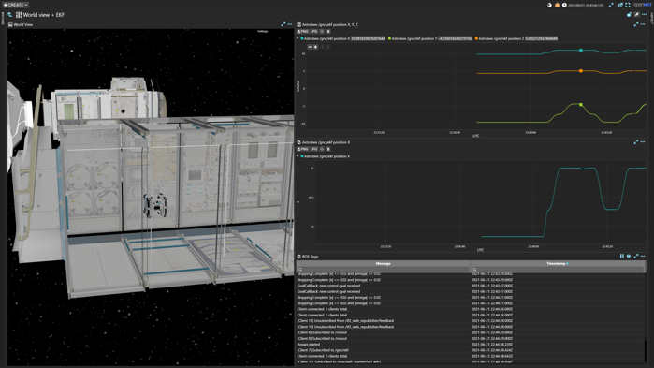
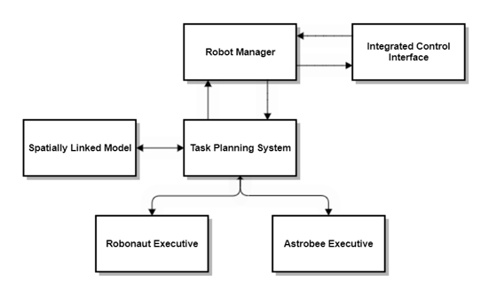
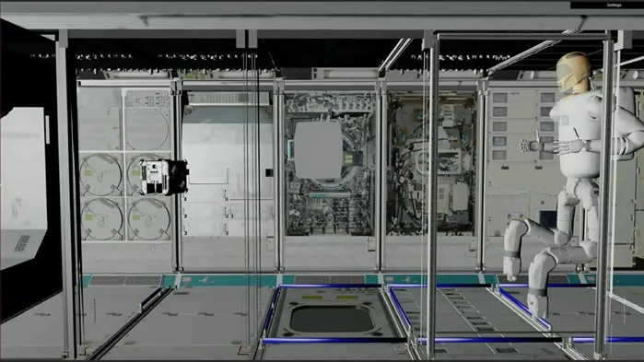
Phase 2 Summary
Integrated Control Interface
Multi-Robot Coordination
Autonomous Logistics Demo
Integrated control interface: improve operator situation awareness and productivity
Multi-robot coordination: automated task planning system generates multi-robot plan and ensures constraints are met
Cargo transfer scenario: heterogeneous multi-robot approach increases productivity
Notes:
Our work on ISAAC phase 2 is still in progress. Phase 2 focuses on improving our integrated control interface, and applying ISAAC technology to autonomous logistics, as you just saw in the video.

Slide 18
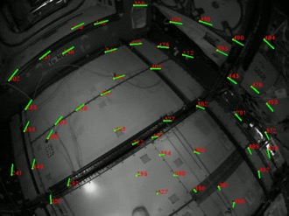
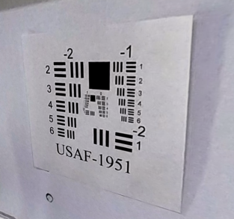
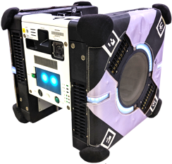
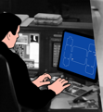
Astrobee Enhancements Summary
Robust Graph Localizer
Astrobee SciCam Computer Vision
SciCam
ROS on Ground Segment
ISAAC has made Astrobee more reliable and autonomous with the new graph localizer, and enabled computer vision with the SciCam
Many other ISAAC updates streamline Astrobee software development and lay the groundwork for future enhancements
These improvements were key enablers for reliably executing ISAAC’s multi-sensor mapping activities
ISAAC’s changes have been incorporated into Astrobee’s baseline flight software, making them available to all Astrobee Facility users
Astrobee flight software
Ground
segment
Node 1
Node 2
Node 3
Node 1
Node 2
Node 3
ROS
ROS
NEW
Astrobee control station
Bridge
Bridge
DDS
Space-to-ground link
Notes:
During our work developing ISAAC mapping software for Astrobee, we recognized that Astrobee’s baseline flight software had some limitations that were blocking us. Luckily, the ISAAC team includes some of the original Astrobee software developers who know the system well, and we were able to provide some enhancements that should benefit all Astrobee users.
Most importantly, Astrobee was having trouble with reliably navigating in the ISS, which is a critical capability for ISAAC’s autonomous mapping surveys. The Astrobee navigation software that worked great in the simple environment of Astrobee’s Granite Lab testing facility at NASA Ames was not as reliable in the highly cluttered and dynamic ISS environment, where moved items or changes in lighting could confuse an Astrobee so it wouldn’t recognize the visual landmarks it relied on to get a position fix. The ISAAC team was able to improve that situation a lot by implementing a graph localizer that more accurately integrates relative position updates from Astrobee’s visual/inertial odometry module, as compared to the baseline localizer, which used a Kalman filter. When tested on 12 ISS telemetry data sets, the graph localizer reduced the number of “lost robot” events from two to zero and reduced the average position error by more than 50%. More importantly, since the graph localizer was deployed, there have been several Astrobee ISS activities that achieved multiple hours of free flying with no astronaut assistance needed.
Another ISAAC contribution was making Astrobee’s highest-resolution camera, the SciCam, available for computer vision. Previously, the SciCam had only been used to provide streaming video to a human operator. ISAAC developed a capability to capture full-resolution SciCam images with fixed focus, and a customized calibration tool to enable SciCam images to be accurately cross-registered with Astrobee’s other cameras to form a coherent 3D map.
There were also many smaller updates we don’t have time to go into.
We hope these ISAAC improvements to Astrobee will continue to help other Astrobee users in the future.

Slide 19
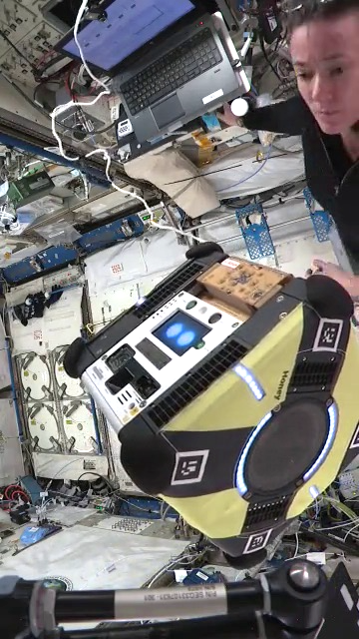
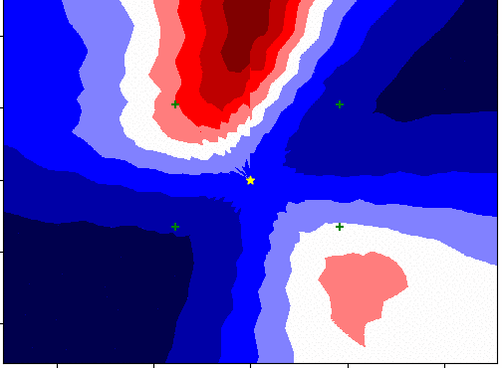
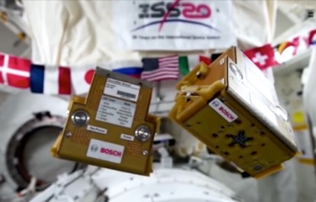
Recent Updates – SoundSee-Data-1 and -2
The SoundSee Astrobee payload is an array of 20 microphones that is designed to
Map sound sources
Perform audio analytics. Example: assess health status of a moving part based on the noise it produces
ISAAC was involved in two Astrobee ISS activities led by the SoundSee team from Bosch USA
SoundSee-Data-1 (2021/07/07)
SoundSee-Data-2 (2021/07/22)
ISAAC assisted with conops and live operational support
Both SoundSee and ISAAC have talented interns who have been working this summer to analyze the ISS data
We plan to demonstrate
Using Astrobee to locate sound sources
Building 3D acoustic maps that fit into ISAAC’s multi-sensor mapping framework
Acoustic images generated from SoundSee data collected during an earlier checkout activity on ISS
SoundSee on ISS
NASA astronaut Megan McArthur prepares Honey for SoundSee-Data-1 operations
Notes:
And a recent update is that last month, ISAAC was able to work with the SoundSee team from Bosch USA to collect ISS acoustic data that could enable us to add a whole new layer to the ISAAC multi-sensor map, which would show the 3D locations of different types of sound sources on the ISS.
The SoundSee Astrobee payload is an array of 20 microphones that is designed to map sound sources and to perform audio analytics. For example, it could assess the health status of a moving part based on the noise it produces.
ISAAC worked with the SoundSee team to develop a SoundSee mapping concept of operations and we helped operate Astrobee on the ISS during these activities. Both teams have talented interns who are in the process of analyzing the data and developing the software to generate acoustic 3D maps. We hope to have initial results in the next few weeks.

Slide 20
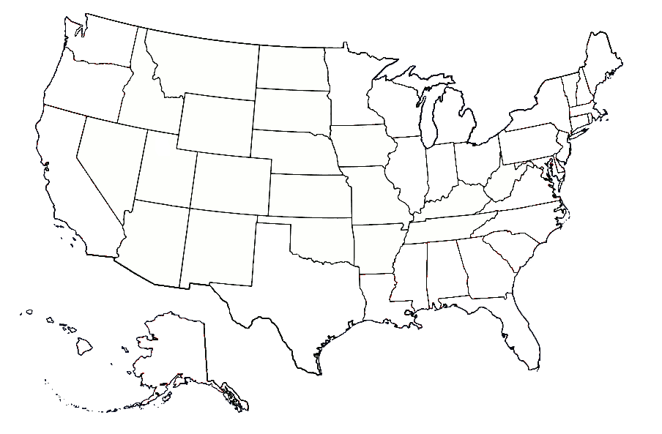
Research Collaborations
Colorado School of Mines ECF, PI Williams
Makel Engineering SBIR, Air quality Astrobee payload
UIUC NSTGRO, Dinkel
Purdue RETHi STRI, PI Dyke
UC Davis HOME STRI, PI Robinson
Carnegie Mellon University HOME STRI
UC Berkeley NSTRF, Ratner
Bosch USA, Pittsburgh SoundSee Astrobee payload
NASA Ames Lead center
Penn NSTRF, Miller
SPEC Sensors STTR, Air quality Astrobee payload
NASA Langley GCD program management
UCLA NSTRF, Millard
UMSL STTR RI, PI Mtibaa
Rice University NSTRF, Wells
NASA Johnson Supporting center
Notes:
ISAAC is a team effort. I would of course like to thank all of the ISAAC core team members whose names are listed on the cover page who worked so hard to develop this technology, but I also want to thank our network of research collaborators from around the country, including NASA graduate research fellows from several universities, various developers of Astrobee sensor payloads whose data we hope to eventually integrate into ISAAC multi-sensor maps, and the two “Smart Habitats” Space Technology Research Institutes, which are university research consortiums that are providing us with a pipeline of both innovative concepts and talented interns.

Slide 21
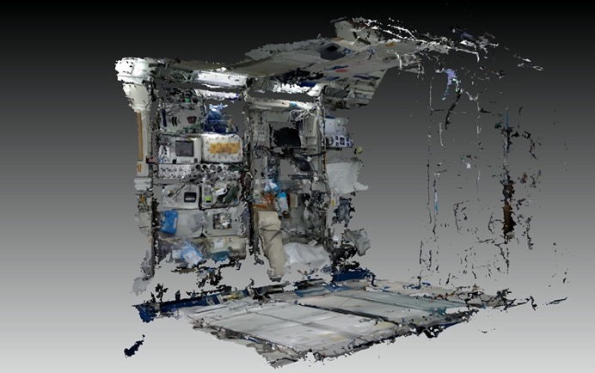
Near-Term Next Steps
Improve phase 2 cargo transport demo
Multiple bags
Automated replanning on action failure
Improve operator interface
Extend effort on multi-sensor 3D mapping
Improve 3D reconstruction quality
Make survey more robust and expand coverage
Incorporate SoundSee acoustic map layer
Make prototype 3D maps of ISS interior available to potential users and pursue infusion into near-term ISS operational use
Continue assisting Astrobee Facility with flight software enhancements
ISAAC Control Interface organized to show 3D robot view, plots, and logs
ISAAC will make prototype 3D maps of ISS interior available for potential users
Notes:
Finally, we’ll talk about some of the near-term next steps for ISAAC.
We’re just wrapping up some improvements to the phase 2 cargo transport scenario we showed earlier. We're scaling up so that the automated planner generates larger multi-robot coordinated plans that include several cargo bags. We’re demonstrating reacting to an action failure by re-invoking the planner, which can generate a Plan B approach, and we’re improving the operator interface.
Another area of upcoming work is extending our effort on multi-sensor 3D mapping. We recognize a need to improve the quality of the 3D maps and get rid of some of the reconstruction artifacts. We also plan to make the survey operations more robust and expand the coverage to include multiple ISS modules. And we hope to make the resulting 3D maps available in a way that will actually help ISS operations. Within the ISAAC team, we’ve already found ourselves using our own 3D maps to understand what ISS payloads are where and decide precisely where Astrobee should fly in an upcoming activity. We think they’re going to be broadly useful to mission controllers as well, for example, to figure out where there’s really space available to stow cargo that’s about to arrive, or to do a safety check looking for clutter that could block the astronauts’ exit path in an emergency.
And as we continue to stretch the envelope of Astrobee capabilities, we’ll also continue to invest in flight software improvements that will benefit other users.

Slide 22
QUESTIONS?
Notes:
Thanks so much for listening, and we hope to hear from you at our Q&A session during the conference!

